Slide 1
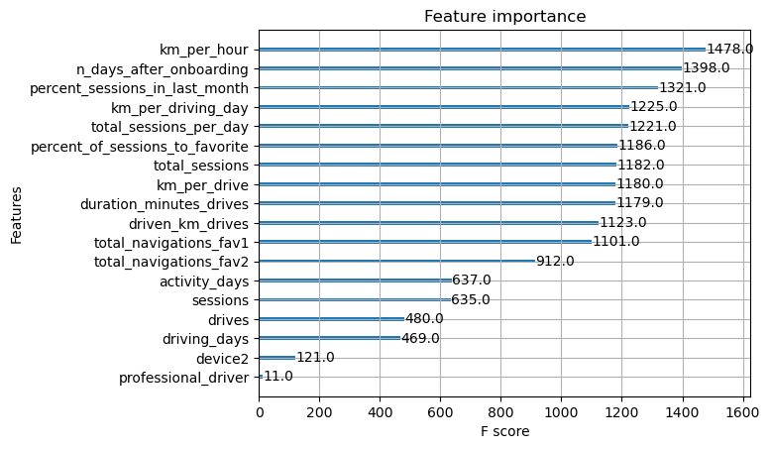
Predicting User Churn in Waze
Leveraging Machine Learning to Improve User Retention
We have developed a machine learning model to predict user churn. This model uses various user behavioral characteristics to identify users who are most likely to leave the app. By taking proactive measures to retain these users, we aim to reduce user churn and increase overall user retention.
User churn is a significant concern for any online service. High churn rates can lead to loss of revenue and negatively impact the overall user experience. Identifying users who are likely to churn allows us to take proactive measures to retain them, thereby improving user satisfaction and loyalty.
Our solution involves the use of machine learning algorithms to analyze user behavioral data and predict user churn. The model uses a variety of user characteristics, such as session frequency, navigation history, and device usage, among others. The model should be able to predict which users are most likely to churn.
Two models, the XGBoost and Random Forest, were developed using data from the Waze app to predict user churn. The XGBoost model was chosen despite having a lower validation score due to its better performance. However, it didn't perform well when tested. To improve its performance, the threshold of predicted probabilities was adjusted. The final model achieved a 50% recall rate and a 30% precision rate. Recall rate is the proportion of actual positive cases (users who churned) that were correctly identified by the model. Precision rate is the proportion of predicted positive cases that represented users who actually churned.
Moving forward, we intend to conduct further feature engineering to enhance the model's performance. Additionally, we will consider trying different types of models or tuning the hyperparameters of the existing models. Our ultimate goal is to improve the model's predictive capabilities for user churn, thereby reducing user churn and increasing user retention.

